Slide 1
신호 최적화 최종발표
ETRI연구연수생 강민수

Slide 2
Contents
Current Model
3x3Grid Single-Agent Model without Restraints(Depreciated)
3x3Grid Decentralized Model without Restraints(Depreciated)
3x3Grid/Dunsan Decentralized Model with Practical Restraints
Dunsan Decentralized CNN/CNN-reduced Model with Practical Restraints
Upcoming Model
Continuous Action Model with Practical Restraints

Slide 3
3x3Grid Single-Agent/Decentralized Model without Restraints(Depreciated)
Condition (seed fixed)
Generating probability 0.133 (left, right), 0.388 (up, down)
Restricted direction of vehicles(via)/Not restricted direction(no via)
Central agent(n_1_1), 9 Agents(decentralized)
State
The number of inflow vehicles from each inflow edge(left, straight)
Action
Deciding next phase(without an order), every 20s (with all yellow 3 seconds)
Reward
Penalty on Pressure (= inflow-outflow)

Slide 4
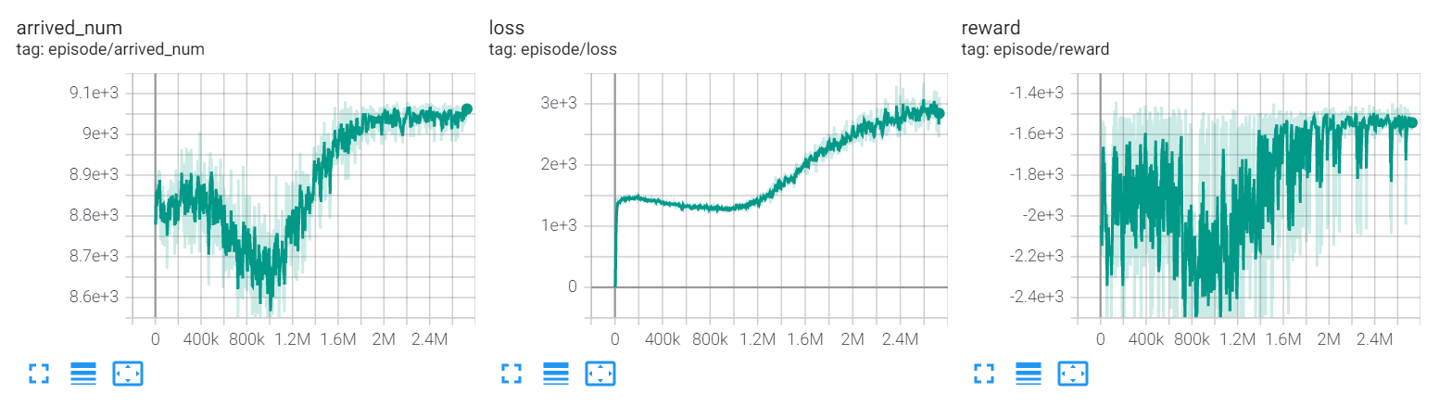

Comparison between Simulation & Single Agent
Simulation 0.133 (left, right), 0.388 (up, down), phase 42(G), 3(Y)
The number of arrived number: 8295 (no via), 8794 (via)
Experiment(Single-Agent Model)
The number of average arrived number: 9060 (no via), 9281 (via)
5~8% Increase
Agent
300m

Slide 5
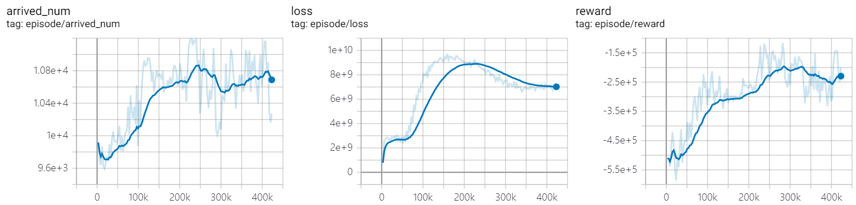
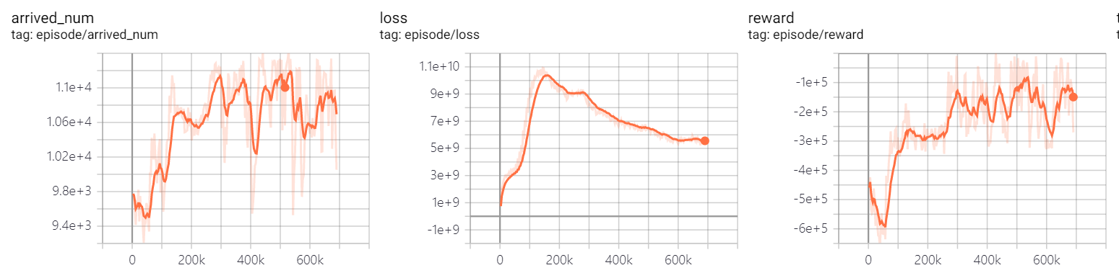
Comparison between Simulation & Decentralized Agents
Simulation 0.133 (left, right), 0.388 (up, down), phase 20(G), 3(y)
The number of arrived number: 9474 (no via), 9765(via)
Experiment(Decentralized Agents Model)
The number of avg arrived number: 10600(no via, blue), 10800 (via, orange)
10~11% Increase

Slide 6
3x3Grid Decentralized Model with Practical Restraints
Condition(seed fixed)
Random routing vehicle generation (period 0.8), scale 1.1 (by randomTrips.py)
9 Decentralized Agents(No offsets, Update Asynchronously)
4 Phases(Vertical/Horizontal straight and left) 37s each, followed by all yellow 3s
Model applied min/max duration(28s,49s) and phase period(160s)
State
The number of inflow vehicles from each inflow edge(left, straight)
Update phase demand(# of vehicles inflow) from end of phase period

Slide 7
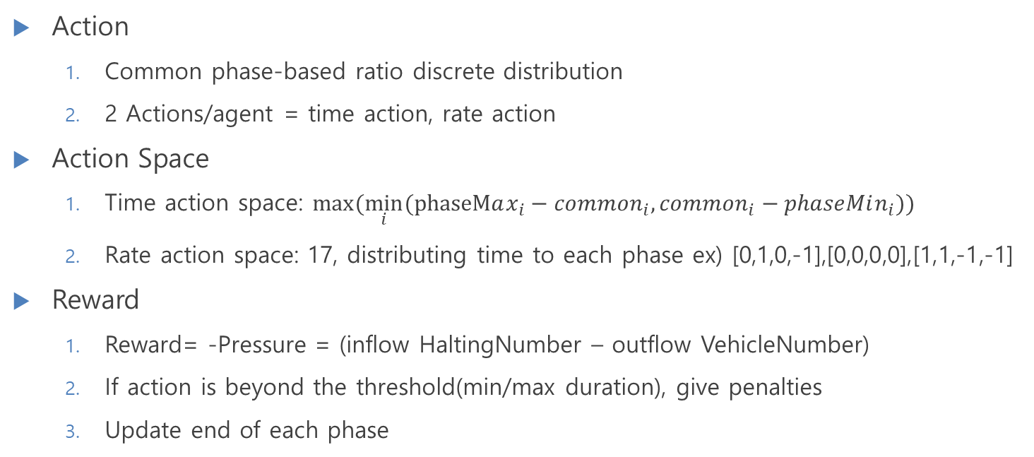
3x3Grid Decentralized Model with Practical Restraints
Action
Common phase-based ratio discrete distribution
2 Actions/agent = time action, rate action
Action Space
Time action space: $max⁡(\min_{i}⁡(phaseMax_{i}−common_{i},common_{i}−phaseMin_{i}))$
Rate action space: 17, distributing time to each phase ex) [0,1,0,-1],[0,0,0,0],[1,1,-1,-1]
Reward
Reward= -Pressure = (inflow HaltingNumber – outflow VehicleNumber)
If action is beyond the threshold(min/max duration), give penalties
Update end of each phase

Slide 8




3x3Grid Decentralized Model with Practical Restraints
Action: $a_{t}^{i}$
RL Modeling
Agent
Agent
Agent
Agent
Environment
Traci
State:$s_{t}$
Neural Net (shared params)
Update Mask
$$i$$
TL_Period
Reward: $r_{t}^{i}$

Slide 9
3x3Grid Decentralized Model with Practical Restraints
# of phase | Action space
2 | 2
3 | 3C2*2+1
4 | (4C2)*3+1
5 | (5C2)*2+(5C4)*(4C2)+1
DNN Modeling
Neural Net (Shared Params)
Left Straight
argmaxQ = rate action
Vehicle Info from Traci
Rate Q Network
argmaxQ = time action
Intersection Traffic Demand
Super Q Network
Time Q Network
Inflow Demand
Concatenated
Traffic Demand

Slide 10
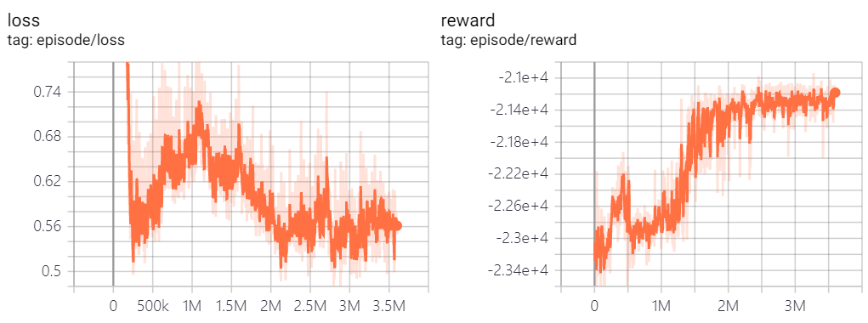
Decentralized Model with Practical Restraints
3x3 grid
9 Agents
Random Routing Generation → 1 period, 1.5 scaled
Dunsan
11 Agents
Real Demand based training → 0-3am, 2.0 scaled
Avg Value | Simulation | Decentralized
Travel Time (per edge) | 25.5s
Velocity | 2.13m/s
Waiting Time (whole trip) | 4205.5s/veh
Avg Value | Simulation | Decentralized
Travel Time (per edge) | 13.82s | 14.52
Velocity | 5.93m/s | 5.769m/s
Waiting Time (whole trip) | 495.5s/veh | 534.1s/veh
Arrived Num | 10951 | 10863

Slide 11
Dunsan Decentralized CNN/CNN-reduced Model with Practical Restraints
CNN based Decentralized Model
CNN: Convolution Neural Network
Feature extraction in selected region → Apply to intersection information
Advantage: less parameters than Fully Connected Network → Lightweighting
CNN based Model (Feature Extraction)
Current Channel: 8 (zero-padded demand of vehicles from inflow edge)
After CNN, the number of channel: 16
Learning Time: 8h 11m
CNN based Lightweight Model
By using Conv1d, dimensionality reduced to 1 channel with feature
Learning Time: 6h 10m

Slide 12
Dunsan Decentralized CNN/CNN-reduced Model with Practical Restraints
CNN based model(Single Agent based Model)
Neural Net (Shared Params)
Left Demand Straight Demand
argmaxQ = rate action
Vehicle Info from Traci
Conv1d
Rate Q Network
argmaxQ = time action
Intersection Traffic Demand
8 Activation Maps/
1 Activation Map
Super Q Network
Time Q Network
Concatenated
Traffic Demand
Other Agents
Inflow Demand (Zero Padded)

Slide 13
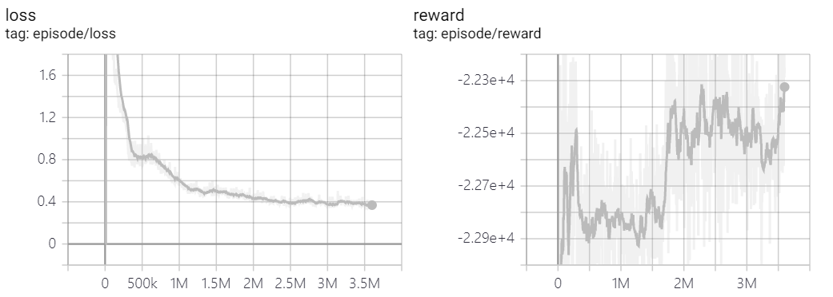
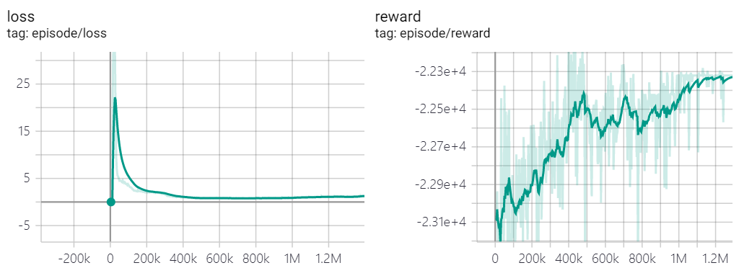
Dunsan Decentralized CNN/CNN-reduced Model with Practical Restraints
CNN Model
8 feature → Checking demand change
CNN-reduced Model
1 feature → Current traffic info
Avg Value | Simulation | Decentralized-CNN | Decentralized-CNN-reduced
Travel Time (per edge) | 13.82s | 14.5s | 14.4s
Velocity | 5.93m/s | 5.79m/s | 5.80m/s
Waiting Time (whole trip) | 495.5s/veh | 534s/veh | 530s/veh
Arrived Num | 10951 | 11022 | 11024
Notes:
어떤 기준으로 평균속도와 Travel time을 결정하게 되었는지 작성해주어야 함

Slide 14
안되는 이유?

Slide 15


Continuous Action Model with Practical Restraints
DDPG based Model
Current action space: Time, Rate → Phase length (for each phase)
Splitting rest of time (Total TL period – sum of min durations for each phase)
Phase distribution by the results of softmax($a_{i}$)
Sum of results by softmax function =1 → Easy to distribute length of phase
DDPG
DDPG target
Action
Update, Approx.
Actor
Actor
Soft Update
$$a_{i}$$
Critic
Critic
Min Duration
State
Environment

Slide 16
Thank you

